Slide 1


Social Buzz:
Top 5 Content Insights Analysis

Slide 2


Today's agenda
Project recap
Problem
The Analytics team
Process
Insights
Summary

Slide 3

Social Buzz is a fast growing social platform who seeking advisory support due to handle their rapid scaling. Accenture has begun a 3 month POC focusing on these tasks.
An audit of their big data practice.
Recommendations for a successful IPO.
An analysis to find Social Buzz’s top 5 most popular categories of content.
Project Recap

Slide 4

Problem
100,000 + pieces of content everyday.
36500000 + posts every year.
80% of the employees are working on maintaining this technology.

Slide 5



Andrew Fleming
Chief Technology Architect
The Analytics team
Marcus Rompton
Senior Principal
Hitesh Garg
Data Analyst

Slide 6
Data Understanding
Process
1
Data Cleaning
2
Data Modelling
3
4
Data Analysis
5
Uncover Insights

Slide 7

Insights
16
ANIMAL
MAY
UNIQUE
CATEGORIES
MOST
POPULAR CATEGORY
MONTH WITH THE MOST POSTS

Slide 8
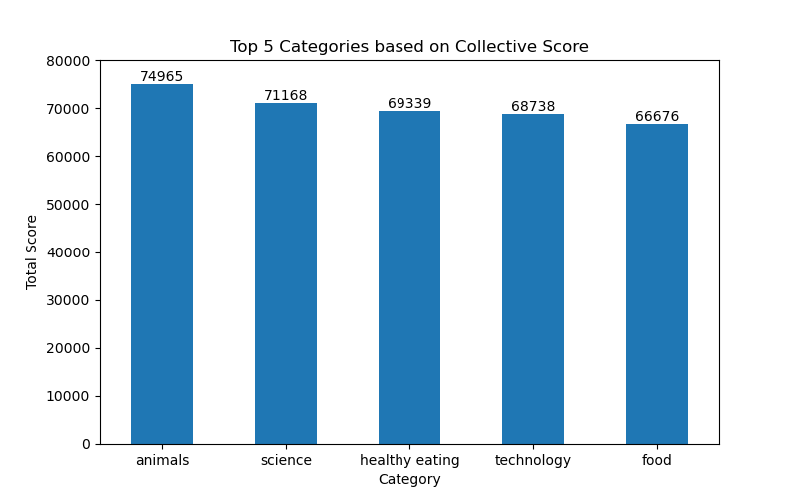

Slide 9
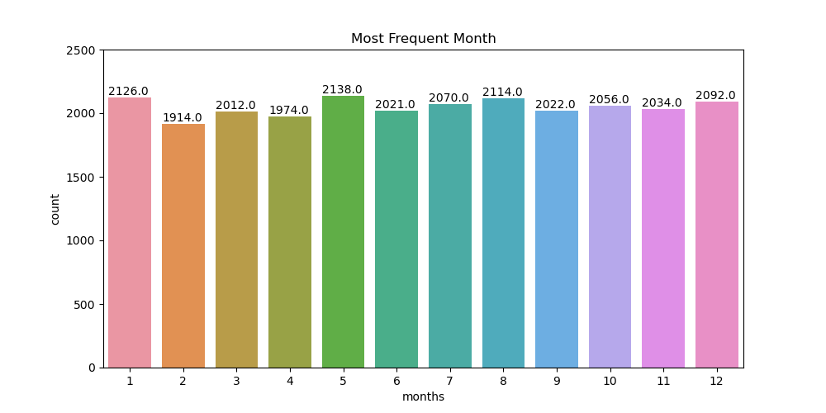

Slide 10

ANALYSIS
Animals and science are the two most popular categories of content, showing that people like “real-life” and “factual” content the most.
INSIGHT
Food is a common theme with the top 5 categories with “Healthy Eating” ranking the highest. You could use this insight to partner with healthy brands and create a campaign to boost engagement.
Summary
NEXT STEPS
This analysis is insightful, but it’s time to take this analysis into large scale production for real-time understanding of your business. We can show you how to do this.

Slide 11
Thank you!
ANY QUESTIONS?

